Slide 1


SMS Texting with ColdFusion & AWS
by Greg Stanley
Notes:
Intro and rundown of presentation.

Slide 2
Companies are only as good as their employees
Notes:
We all know that “companies are only as good as their employees”

Slide 3
Retensa helps companies retain their best employees
Notes:
Retensa helps them retain their best employees.
TalentPulse is our software, which I’ll be showing you in a few minutes,
but one of the many things it does is deliver surveys to employees.
One of the challenges we have is to make sure these surveys get delivered to the people we send them to.

Slide 4
Notes:
Raise your hand if you use chat applications?
Today, chat applications like Slack, WhatsApp, and iMessage, have all made emails somewhat obsolete.
So the best way to reach people nowadays, is with a text.
Think about it —

Slide 5
Notes:
How many unanswered text messages to you have on your phone right now?
How many unanswered emails do you have?
Raise you hand - if you have more unanswered emails?
Receiving a survey in a Text is definitely more convenient for a lot of people, so we made it a priority in our software.
Today, I’m excited to share with you our SMS Texting solution, which uses ColdFusion and Amazon Pinpoint.

Slide 6
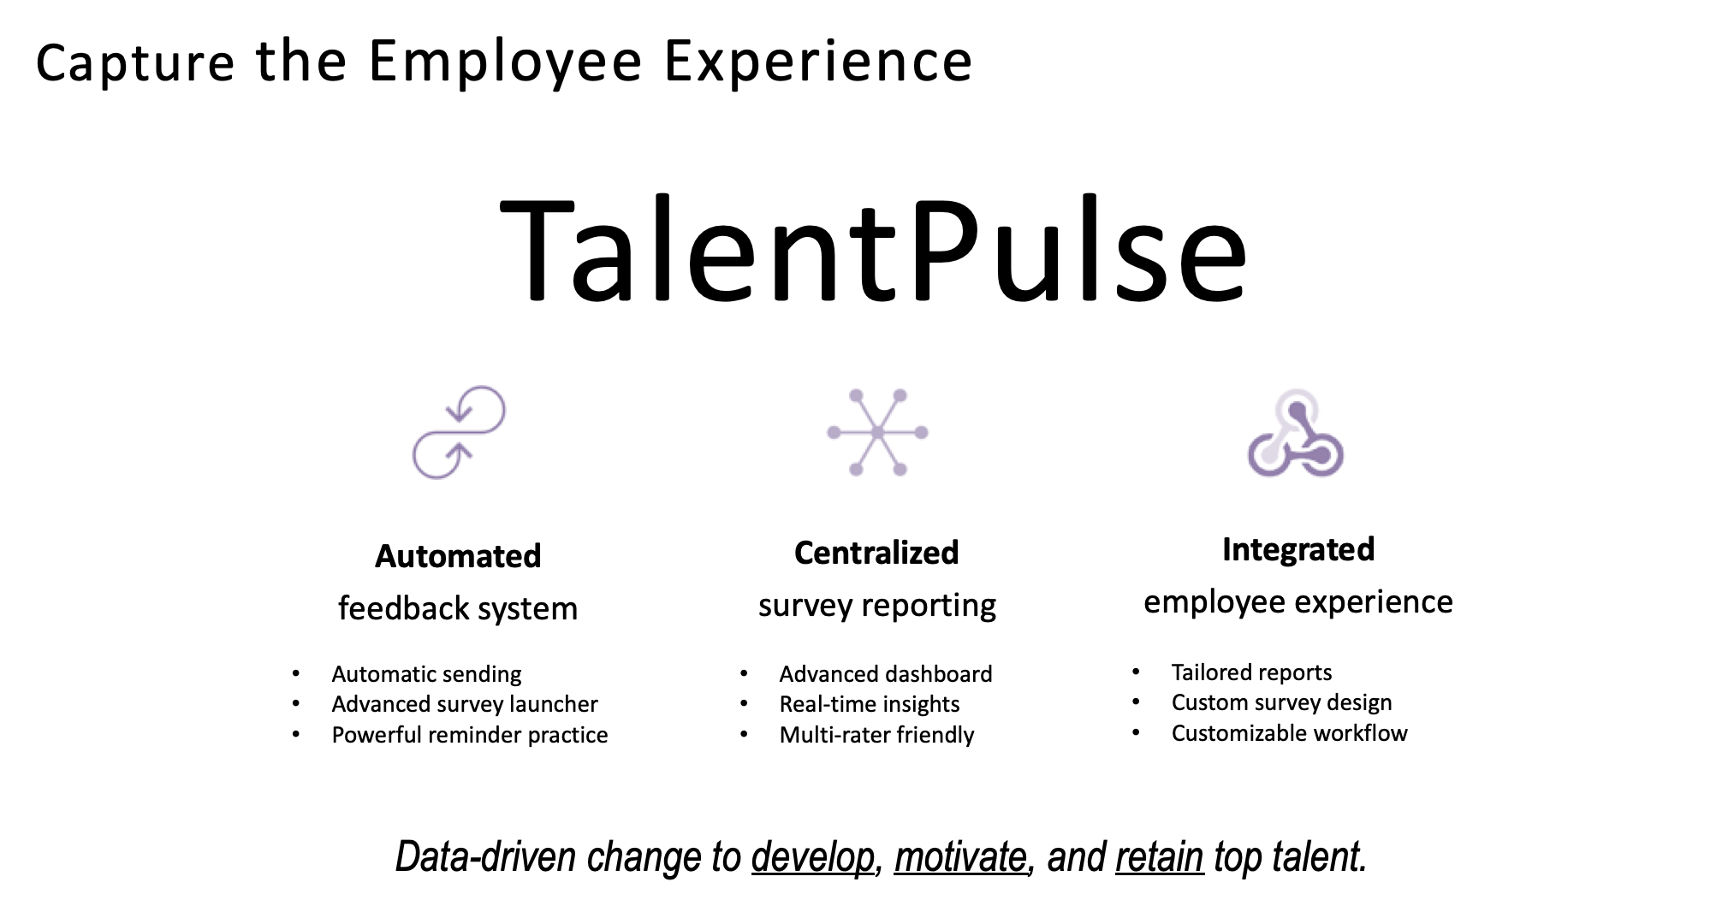
Notes:
Our software is called TalentPulse — and the people that use it are HR and Talent Management depts.
Raise your hand — if you’ve ever taken an employee survey?
Ever wonder what happens to all of your answers?

Slide 7
Last generation of survey software
Notes:
Most HR depts WANT to do something with them — but the last generation of survey software kind of sucks.

Slide 8
Notes:
So we built a platform that automates the collection of feedback — and streamlines the reporting of it.
So now instead of HR depts spending weeks struggling to make sense of the data — using Excel or whatever — They can take action faster and easier. And translate your answers into meaningful change at your company.

Slide 9
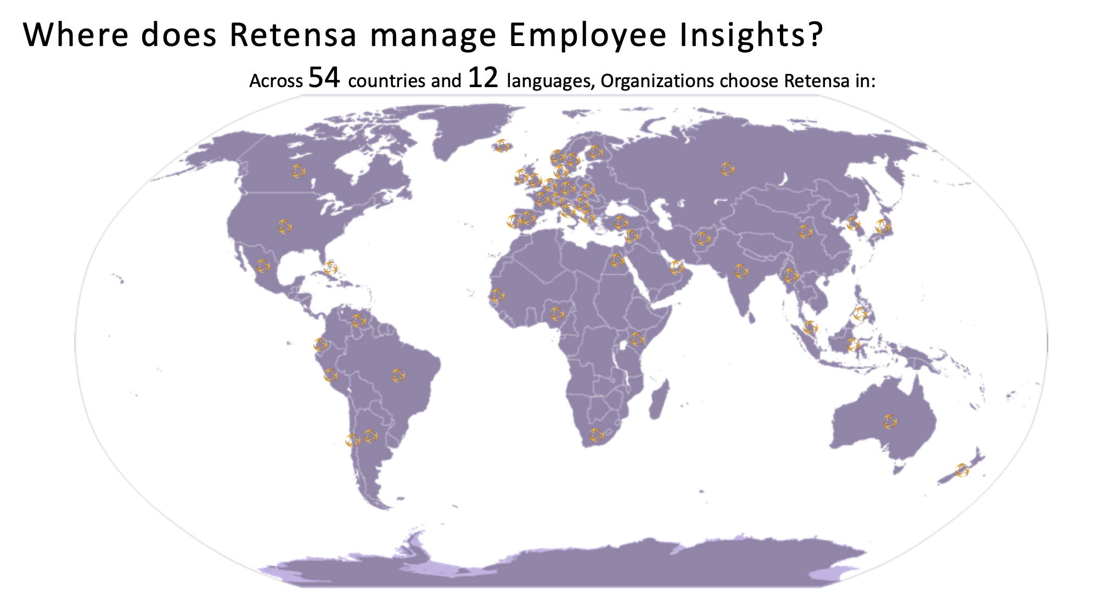
Notes:
We currently have clients in 54 countries and in 12 languages.

Slide 10
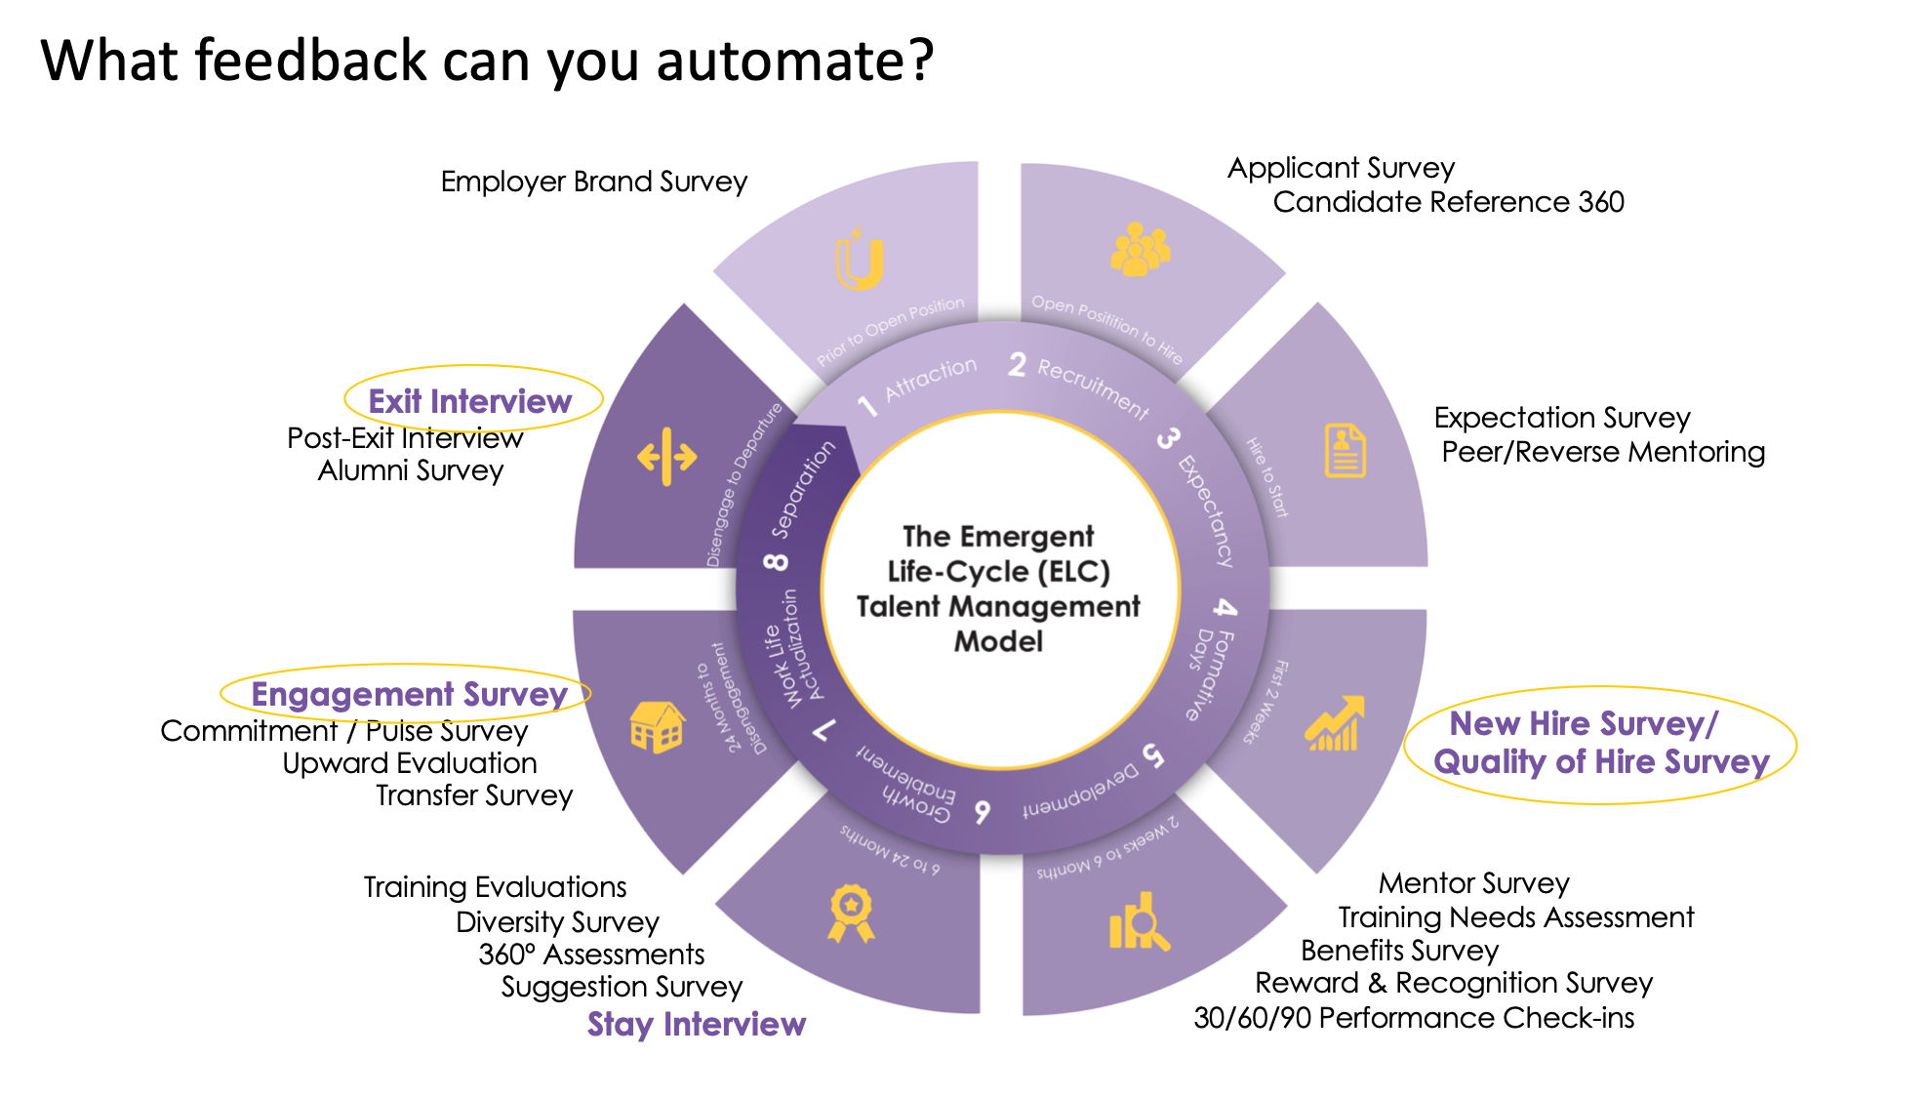
Notes:
TalentPulse manages the entire Employee Life Cycle — from New Hire Surveys — to Exit Interviews —
and everything in between.

Slide 11
Demo Retensa's
SMS Texting
Solution
Notes:
Raise your hand — if you’re a fan of Superman - comics or movies?

Slide 13
Notes:
Today, our fictional demo (of SMS Texting) takes place in the DC universe at The Daily Planet.
I don’t know if you know this, but The Daily Planet has been a client of Retensa for some time now.
They use TalentPulse everyday for their employees.
Well today is a big day, because it happens to be Clark Kent’s last day at the Planet.

Slide 14
BREAKING NEWS
Clark Kent Quits The Daily Planet
Notes:
I just got authorization from HR at the Planet — and they’re going to let us use TalentPulse to send Clark his Exit Interview Survey. Very cool. So let’s do it!
**EXIT SLIDES**

Slide 15
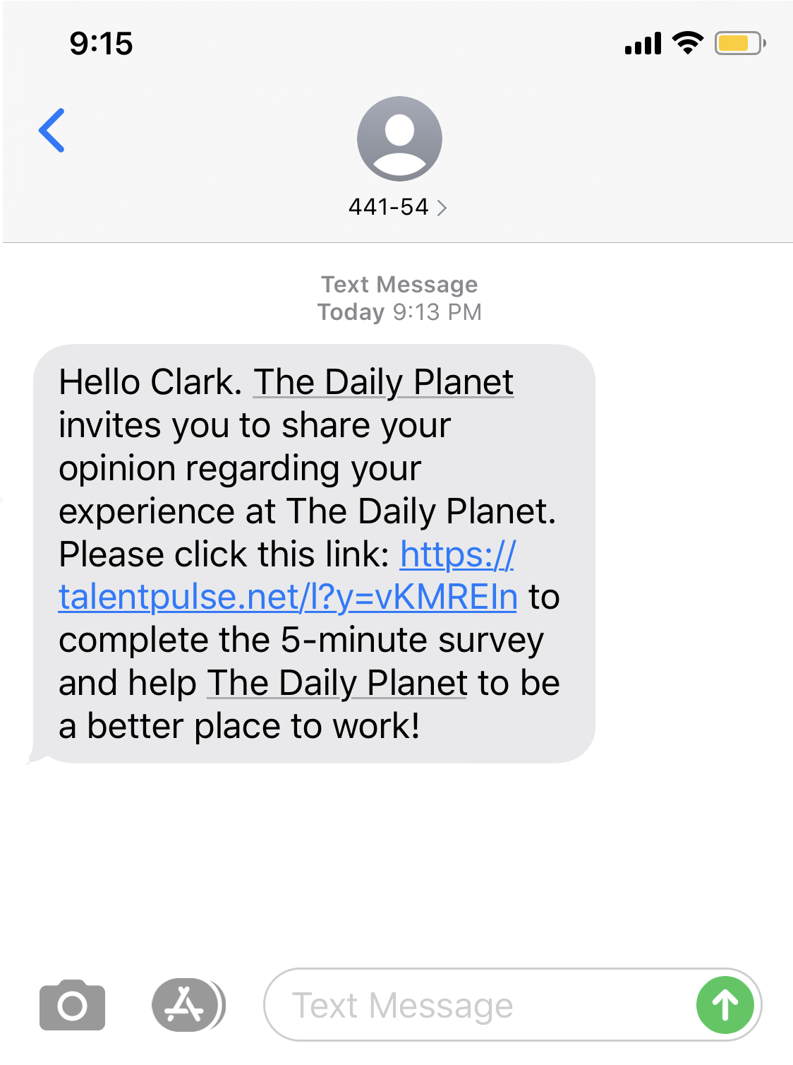
SMS Text from Retensa

Slide 16
What the heck is Amazon Pinpoint?

Slide 17

What the heck is Amazon Pinpoint?
aws.amazon.com/pinpoint/features
SMS: Send text messages to your customers around the world
441-54 >
Notes:
THIS presentation is all about sending SMS text messages… but there are other cool things Pinpoint can do.
One way text uses: airline check-ins, school reminders, package tracking status.

Slide 18
What the heck is Amazon Pinpoint?
aws.amazon.com/pinpoint/features
SMS: Send text messages to your customers around the world
SMS: Create meaningful, interactive engagements (chat-like interactive experience)
Notes:
examples:
T-Mobile survey
Bank verifying charge

Slide 19

What the heck is Amazon Pinpoint?
aws.amazon.com/pinpoint/features
SMS: Send text messages to your customers around the world
SMS: Create meaningful, interactive engagements (chat-like interactive experience)
Push Notifications for mobile apps
Email: Track email responses and other sending statistics (funnels - numbers of sends, deliveries, opens, clicks, bounces, complaints, and rejections)
Voice: Programmatically make phone calls to your customers around the world. Turn your text into lifelike speech (Amazon Polly).

Slide 20
Why we chose Amazon Pinpoint for Sending Texts
Can send text messages to US & International numbers docs.aws.amazon.com/pinpoint/latest/userguide/channels-sms-countries.html
Can validate numbers to ensure they are mobile before sending (not available in SNS)
Opting out is handled automatically (user can reply STOP to opt out of future texts)
Costs $.00645 per request to validate any phone number
Costs $.00645 per request to send in the US. A lot of the other countries are around that price too, however they vary and can be seen here: aws.amazon.com/pinpoint/pricing
Notes:
We have clients in 54 countries - so we needed a robust solution that could send texts to the world, not just the US.
Talk about each!

Slide 21
Any Limits or Restrictions?
Texting character limit
Over 200 countries supported, but not all
Content Restriction
Notes:
Texting character limit? Although text messages are limited to 160 characters, most modern phones and networks support concatenation and segment and rebuild messages up to 1600 characters.
Over 200 countries - NOT Cuba, Iran, North Korea, Syria, and Sudan.
Content Restriction?
Most countries have restrictions on content
Pornographic content
Content that has profanity or is hateful
Content that depicts or endorses violence
Content that endorses illegal drugs
May be fees involved if it’s reported

Slide 22

SMS Now or Later?
Message Types
Transactional - Critical messages that support customer transactions, such as one-time passcodes for multi-factor authentication.
Promotional - Noncritical messages, such as marketing messages.

Slide 23
Who sent that text?
Originating Sender (a few options):
Free Shared Short Code (default)
Notes:
We use free shared short code for one way texting.

Slide 24

Who sent that text?
Originating Sender (a few options):
Free Shared Short Code (default)
Dedicated Short Code (pricey)
Notes:
Dedicated Short Code
Needed if you want people to text you!!
Takes 8-12 weeks to get one
$650 setup fee
$900 monthly fee.

Slide 25
Who sent that text?
Originating Sender (a few options):
Free Shared Short Code (default)
Dedicated Short Code (pricey)
Dedicated Long Code
Notes:
-Long Codes: 11 or 12 digit number (includes country code).
Amazon doesn't recommend using this if you are sending one way text messages.
Must request a long code from Amazon.
Limit 1 message per second.
Some other restrictions by country.

Slide 26
Who sent that text?
Originating Sender (a few options):
Free Shared Short Code (default)
Dedicated Short Code (pricey)
Dedicated Long Code
Sender ID
Notes:
-Sender IDs: A brand or business name. Not supported in US, Canada and China.

Slide 27
Who sent that text?
Originating Sender (a few options):
Free Shared Short Code (default)
Notes:
FOR ONE WAY TEXTING - We use free shared short code.

Slide 28
How To Minimize AWS Costs
Store validation results in the Database
Notes:
So we never validate the same number more than once.

Slide 29
Create a Killer UX
Use International Telephone Input intl-tel-input.com
Notes:
free number formatting and digit validating for all countries
cool flags
Does NOT determine if mobile or landline

Slide 30
This is sweet!
How do I start using it?
Notes:
What do you have to do to have full access to AWS services inside ColdFusion?

Slide 31
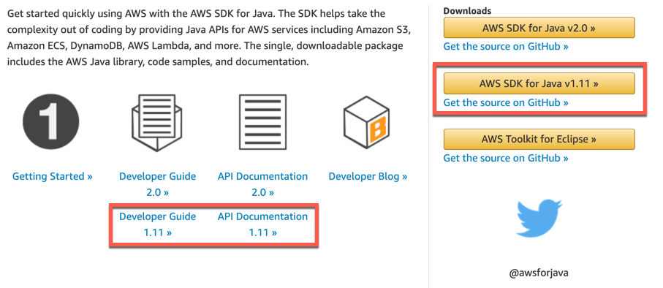
AWS SDK for Java
Download here: aws.amazon.com/sdk-for-java
Notes:
You’re going to need to add the Java SDK into ColdFusion.

Slide 32
AWS SDK for Java
Download here: aws.amazon.com/sdk-for-java
To have access to the full power of the AWS Java SDK, copy these .jar files to your cfusion/lib directory.
Adobe ColdFusion 2018:
aws-java-sdk-1.11.xxx.jar
Adobe ColdFusion 2016 or 11:
aws-java-sdk-1.11.xxx.jar
jackson-annotations-2.6.0.jar
jackson-core-2.6.7.jar
jackson-databind-2.6.7.1.jar
joda-time-2.8.1.jar
Notes:
1.11 is still preferred method - since Adobe is starting to include that in CF.
Brian’s awsPlaybox is also using v1.11.
CF 2020 will include AWS Java SDK!

Slide 33
awsPlaybox
github.com/brianklaas/awsPlaybox
With the awsPlaybox, you’ll be up and running with ColdFusion and AWS within a few minutes.
Currently, the awsPlaybox includes the following AWS modules:
DynamoDB
IAM
Lambda
Rekognition
SNS
Step Functions
Transcribe
Translate
Created by Brian Klaas
brianklaas.net
Notes:
Big shout out to Brian!

Slide 34
What does the code look like?

Slide 35

model/awsCredentials.cfc - set your AWS keys
component accessors="true" output="false" hint="Simpler holder for AWS credentials." {
property name="accessKey" type="string";
property name="secretKey" type="string";
this.accessKey = 'YOUR IAM ACCESS KEY GOES HERE';
this.secretKey = 'YOUR IAM SECRET KEY GOES HERE';
/**
* @description Component initialization
*/
public any function init() {
return this;
}
}

Slide 36

model/awsServiceFactory.cfc - add pinpoint code below
case 'rekognition':
javaObjectName = "com.amazonaws.services.rekognition.AmazonRekognitionClientBuilder";
break;
case 'pinpoint':
javaObjectName = "com.amazonaws.services.pinpoint.AmazonPinpointClientBuilder";
break;
case 'sns':
javaObjectName = "com.amazonaws.services.sns.AmazonSNSClientBuilder";
break;

Slide 37

application.cfc - add pinpoint code below
this.name = 'awsPlaybox';
this.applicationTimeout = CreateTimeSpan(0, 0, 15, 0);
this.sessionManagement = false;
this.datasource = 'my-cf-datasource'; /* added for Pinpoint */
.
.
.
// Pinpoint Project ID -- this is the Pinpoint Project ID in your AWS account, under Pinpoint -> All Projects
application.pinpointProjectID = "1234567890"; /* added for Pinpoint */
return true;

Slide 38
How do I create the database tables used to minimize AWS costs?
In the new /pinpoint directory, there is a file called pinpoint.sql, which has the script to create the 3 tables used in the code. Run this in your database.

Slide 39

Validate phone number using AWS Pinpoint
<cfset local.NumberValidateRequest =
CreateObject('java', ‘com.amazonaws.services.pinpoint.model.NumberValidateRequest’)
.withPhoneNumber(arguments.phone)>
<cfset local.PhoneNumberValidateRequest =
CreateObject('java', ‘com.amazonaws.services.pinpoint.model.PhoneNumberValidateRequest')
.withNumberValidateRequest(local.NumberValidateRequest)>
<cfset local.pinpoint =
application.awsServiceFactory.createServiceObject('pinpoint')>
<cfset local.pinres =
local.pinpoint.phoneNumberValidate(local.PhoneNumberValidateRequest)>

Slide 40

Send Text Message using AWS Pinpoint
<cfset local.smsMessage =
CreateObject('java', ‘com.amazonaws.services.pinpoint.model.SMSMessage’)
.withBody(arguments.messageBody)
.withMessageType('TRANSACTIONAL')>
<cfset local.directMessageConfiguration =
CreateObject('java', ‘com.amazonaws.services.pinpoint.model.DirectMessageConfiguration')
.withSMSMessage(local.smsMessage)>
<cfset local.messageRequest =
CreateObject('java', ‘com.amazonaws.services.pinpoint.model.MessageRequest')
.withMessageConfiguration(local.directMessageConfiguration)>
<cfset local.addressConfiguration =
CreateObject('java', ‘com.amazonaws.services.pinpoint.model.AddressConfiguration')
.withBodyOverride(arguments.messageBody)
.withChannelType('SMS')>
<cfset local.messageRequest.addAddressesEntry(arguments.phone, local.addressConfiguration)>
<cfset local.sendMessagesRequest =
CreateObject('java', ‘com.amazonaws.services.pinpoint.model.SendMessagesRequest')
.withApplicationId(application.pinpointProjectID)
.withMessageRequest(local.messageRequest)>
<cfset local.pinpoint = application.awsServiceFactory.createServiceObject('pinpoint') />
<cfset local.pinres = local.pinpoint.sendMessages(local.sendMessagesRequest)>

Slide 41
Some wrappers to make things easier
awsValidatePhone - Validate a number with Pinpoint. Results are stored in table SMSValidateLog.
awsSendSMS - Send a text message with Pinpoint. Results are stored in table SMSSendLog.
SMSCheck - Checks the DB to see if the number was already validated, otherwise, awsValidatePhone is called and DB is updated with results.
Notes:
Finish up with some wrappers to make life a little easier.
Pinpoint will not likely be included in CF 2020.

Slide 42



THANK YOU!
Discover the next generation of Talent Management solutions:
Employee Feedback Platform
www.TalentPulse.com
Exit Interview and Separation Management
www.TalentPulse.com
Employee Retention Strategies
www.Retensa.com
Want 10 Free Exit Interviews for your company? Visit retensa.com/event42
Greg Stanley
gregstanley1@gmail.com
Twitter: gregstanley1
Presentation Slides and Demo Code will be available for download here:
gregstanley.com/pinpoint

